Slide 1



WEB PHISHING DETECTION USING IBM WATSON
Smartinternz Guided Project
Team CSE_AIML_C02
18481A05C6 - K. Hebsiba
18481A05E0 - Fareena Simmin
18481A05E8 - N. Sai Spandana

Slide 2
INTRODUCTION
Phishing are one of the most common and most dangerous attacks among cybercrimes. The aim of these attacks is to steal the information used by individuals and organizations to conduct transactions. Phishing attack causes serious threats to user’s privacy and security. It is the fraudulent attempt to obtain sensitive information of individuals or organization such as usernames, passwords and credit card details by disguising as trustworthy entity in an electronic communication. In early years phishing websites are detected by some techniques but there were drawback as system cannot be early predicting the phishing in modern sites and it take more time for processing. This problem can be easily solved by using any of the machine learning algorithm with the classifier which detect them in efficient way and give most accurate score.

Slide 3
EXISTING SYSTEM
The existing system uses the classifiers, fusion algorithm, and Bayesian model to detect the phishing sites. The classifiers can classify the text content and image content. Internet has become an essential component of our every day social and financial activities. Nevertheless, internet users may be vulnerable to different types of web threats, which may cause financial damages, identity theft, loss of private information and loss of customers confidence in ecommerce and online banking.
And then later, data is collected from Phish Tank and legitimate URLs from Google. To obtain the text properties C# programming and R programming were used. 133 features were obtained from the dataset and third party service providers. CFS subset based and Consistency subset based feature selection methods used for feature selection and analyzed with WEKA tool. Naïve Bayes and Sequential Minimal Optimization (SMO) algorithms were compared for performance evaluation and SMO is preferred by the author for phishing detection than NB

Slide 4
PROPOSED METHOD
We proposed an intelligent, flexible and effective system that is based on using classification algorithms. There are many algorithms that are used to detect the phishing websites accurately. Few of them used to classify the URL as legitimate or phished. The publicly available phishing websites data set from the machine learning repository can be used for training and testing. The features of the dataset are used to predict the result.
Once a user makes a transaction online when he makes payment through an e-banking website our system will use a data mining algorithm to detect whether the e-banking website is a phishing website or not. After the model is built , we will integrating it to web application so that normal users can also use it to know if any website is phishing or safe in a no-code manner. In the application, the user provides any website URL to check and the corresponding parameter values are generated by analysing the URL using which legitimate websites are detected.

Slide 5
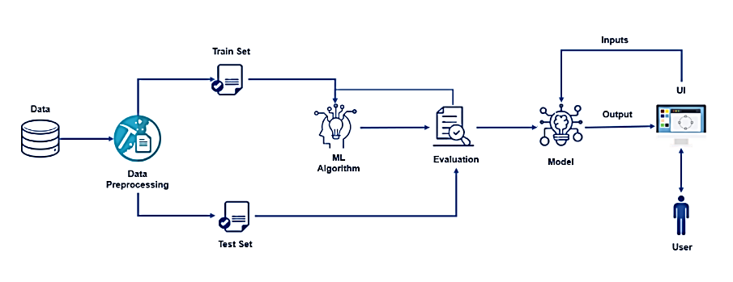
ARCHITECTURE

Slide 6

IMPLEMENTATION
To start the implementation , we have to select or identify a dataset which contains a set of features through which a phishing website can be identified. In this milestone, we will be pre-processing the dataset that is collected.
1. Pre-processing includes
Handling the null values.
Handling the categorical values if any.
Normalize the data if required.
Identifying the dependent and independent variables.
Split the dataset into train and test sets.

Slide 7

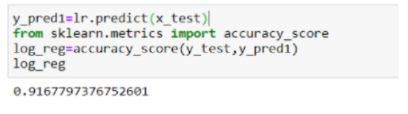
2. Model Building
There are several Machine Learning algorithms to be used depending on the data you are going to process such as images, sound, text, and numerical values. The algorithms can be chosen according to the objective. As the dataset which we are using is a Classification dataset we can use the following algorithms
Logistic Regression
Random Forest Regression / Classification
Decision Tree Regression / Classification
K-Nearest Neighbors
Support Vector Machine
3. In order to get appropriate predictions, the dataset can be trained with any of the above algorithms. To avoid overfitting, we considered Logistics Regression.
The accuracy of Logistic Regression of given dataset is 91.6%

Slide 8





4. Save the model and its dependencies. The finalized model will saved by as a pickle or pkl file.
5. Build a Web application using a flask that integrates with the model built.
commands to import required libraries-
Load the model and initialize Flask App
Fetch the URL from the UI, process the URL , get the input parameters from the URL and return the Prediction
Run the app

Slide 9
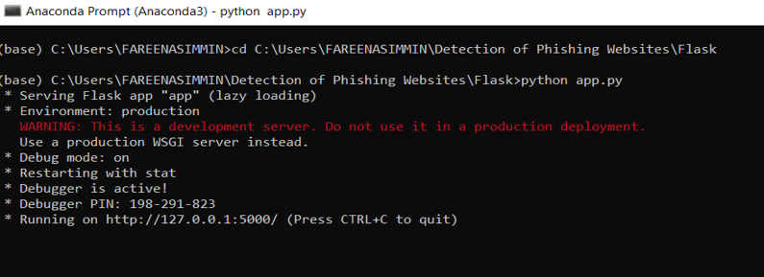
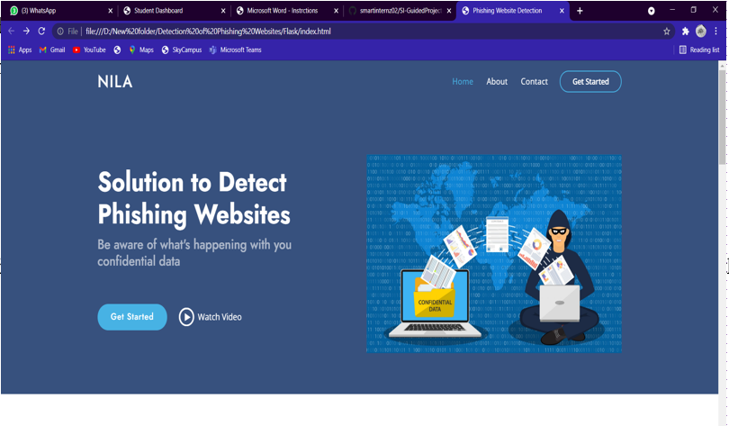
6. Build An HTML Page to take the URL as a text and upon clicking on the button for submission it has to re direct to URL for “y_predict” which returns if the URL given is Phishing or safe. The output is to be then displayed on then displayed on the page
7. Execute the python
code in anaconda
prompt
8. Now while the app is running open index.html , the above is the home page of the web application.

Slide 10
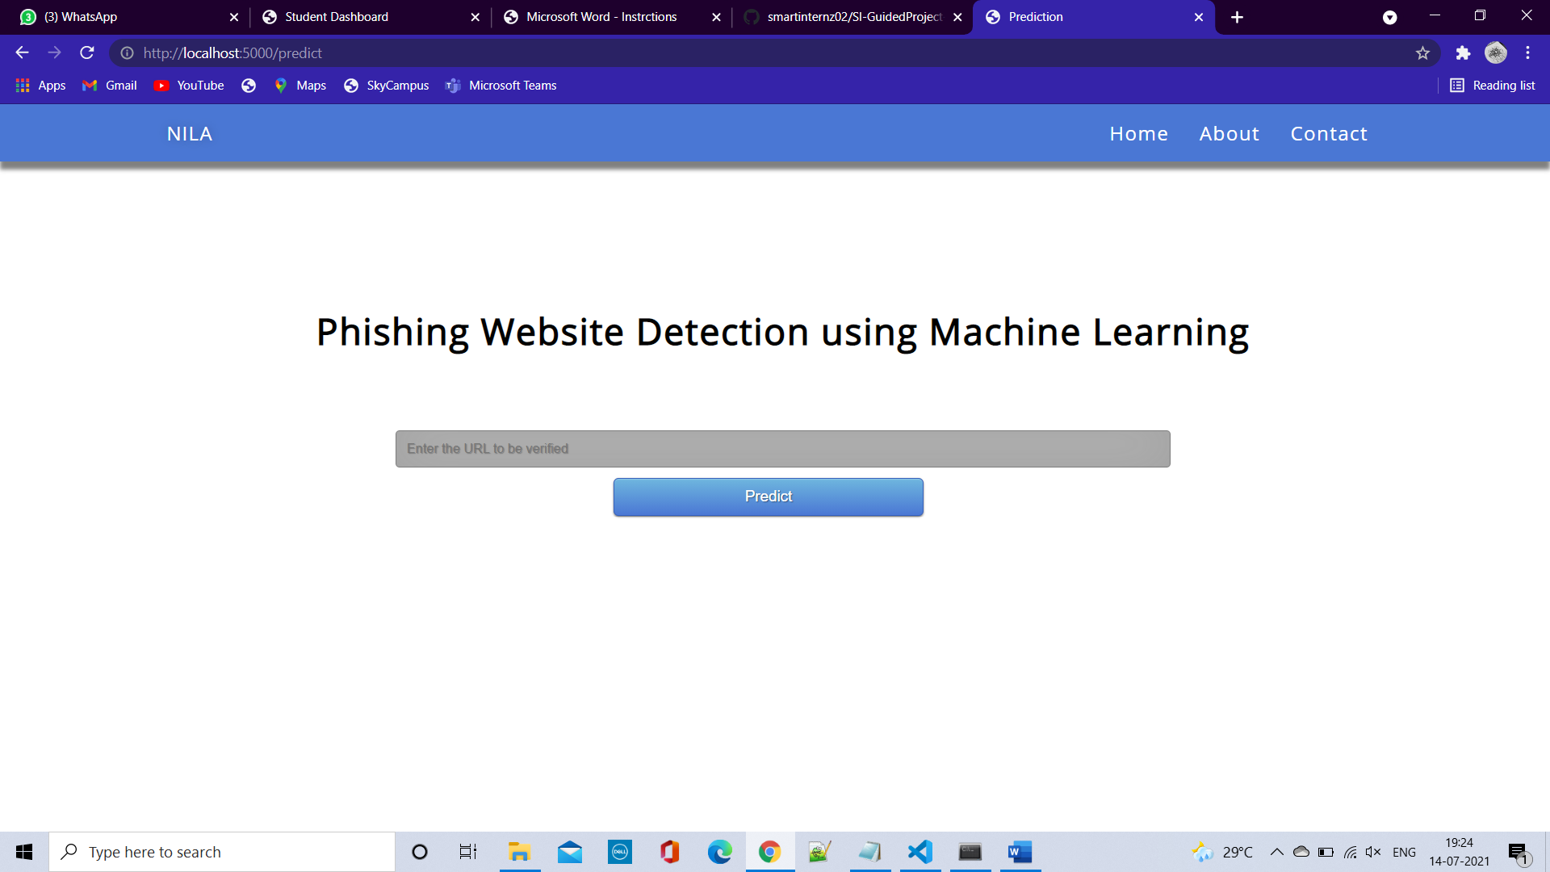
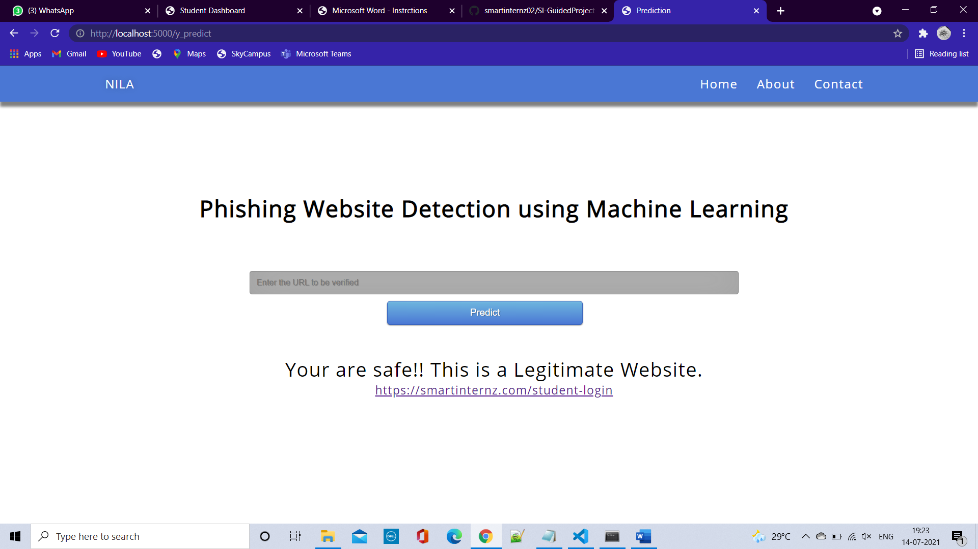
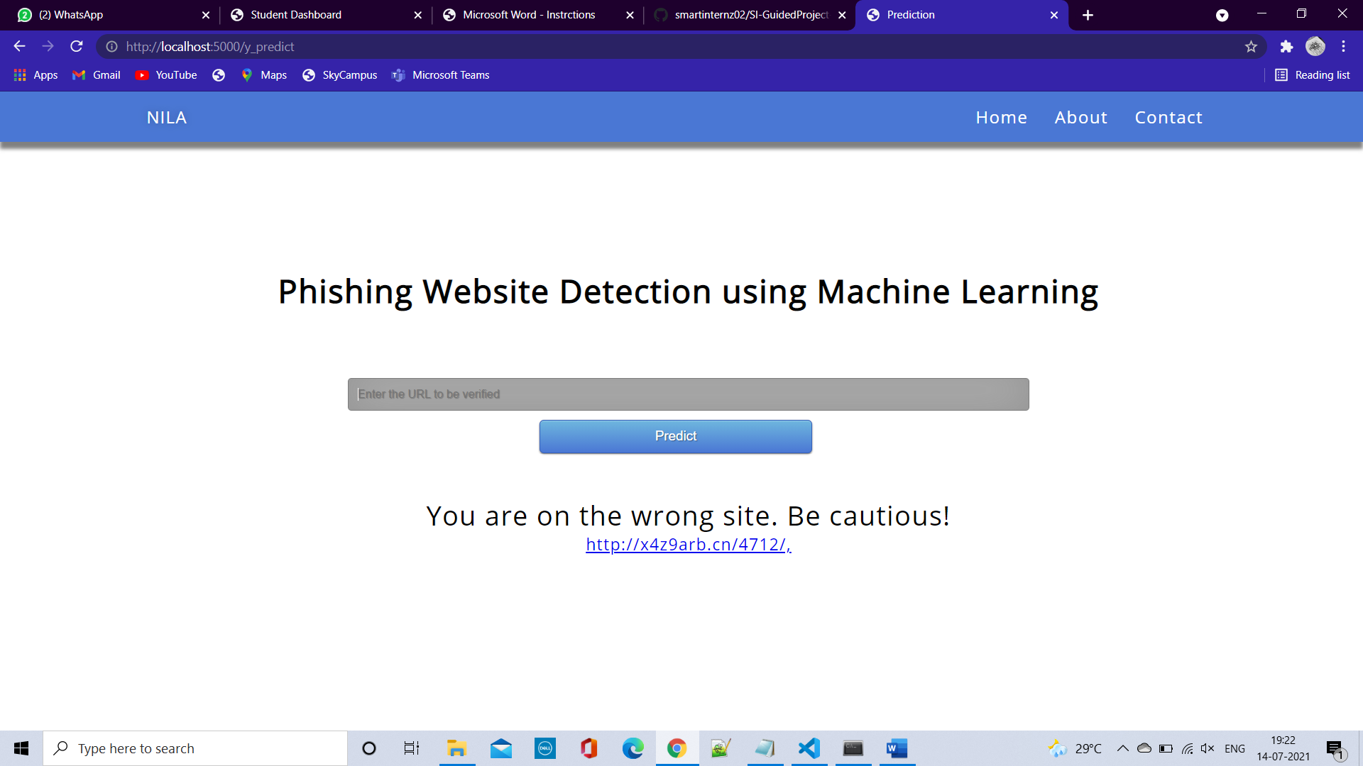
Click on Get started or Check your website button , the user will be redirected to the below page where user can specify the URL.
When the URL is given , the model analyses and gives the output whether it is Phishing or legitimate website. The below are output of the model, fig1is an example for Legitimate website and fig2 is for the Phishing website.
fig.1 fig.2

Slide 11
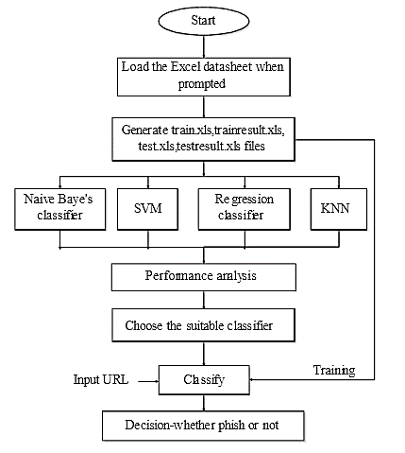
PROCESS FLOW
Our main objective is to detect whether the URL is phishing or legitimate based on the features extracted respective to 31 fields dataset .And URL input is unstructured format. In Pre-processing we have done feature extraction where The URLs are transmitted to the feature extractor, which extracts feature values through the predefined URL-based features. The features have assigned binary values 0 and 1 which indicates that feature is present or not as shown in figure below. The extracted feature values are stored as input and passed to the classifiers.
When there is a page request, the URL of the requested site is radiated to the feature extractor. It extracts the feature values through the predefined URL-based features. These feature values are act as a input for the classifier. After this we will come to know if the site is phishing or not.

Slide 12
Advantages
The accuracy of proposed is expected to improve by effectively integrating information from multiple sources for model training.
Reduce the processing time.
Easily can detect whether any user given URL is phishing or legitimate.
Disadvantages
It will lead to information disclosure and property damage.
Large organizations may get trapped in different kinds of scams.
It cannot be early predicting the phishing in modern sites.
It takes more time for processing

Slide 13
Execution

Slide 14
CONCLUSION
It is found that phishing attacks is very crucial and it is important for us to get a mechanism to detect it. As very important and personal information of the user can be leaked through phishing websites, it becomes more critical to take care of this issue. This problem can be easily solved by using any of the machine learning algorithm with the classifier. We have seen that existing system gives less accuracy so we proposed a new phishing method that employs URL based features and also, we generated classifiers through machine learning.

Slide 15
Thank YOU

